Slide 1
B.Tech Project
Inventory and distribution routing for a multi-product supply chain model for spare parts in Automobile company
Under the supervision of
Prof. Biswajit Mahanty
Mohammed Raafid M V | 20MF3IM33

Slide 2
Introduction
Inventory management and Transportation are vital for supply chain efficiency.
It ensures seamless movement of products from production to point of sale.
Our core aim is having the right products available at the right place and time
Enhancing efficiency, reducing costs, and maximizing operational potential

Slide 3
Problem Statement
Consider a Manufacturing Plant at Hosur with 8 Distribution center from
Tamil Nadu
Let us consider the number of parts are 5 parts and, 4 weeks period
Focus on 5 parts that are being supplied to the distribution centers via
5 transportation companies
Truck capacity 7 Tonne truck is used by all the vehicles from different transporters

Slide 4
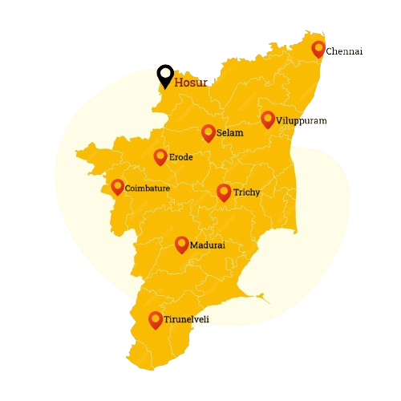
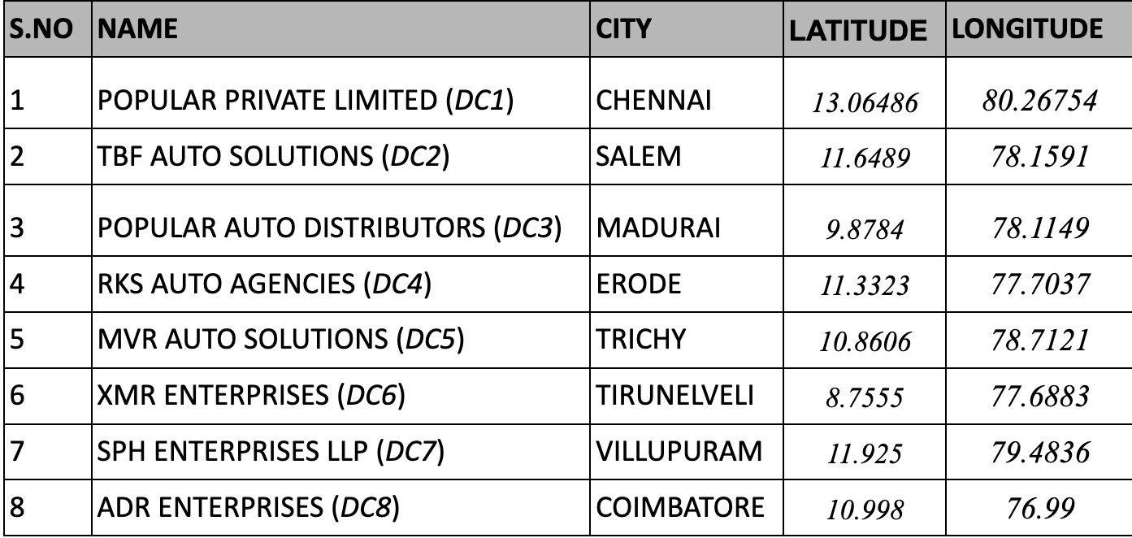
Locations
Main Manufacturing Plant is at Hosur

Slide 5
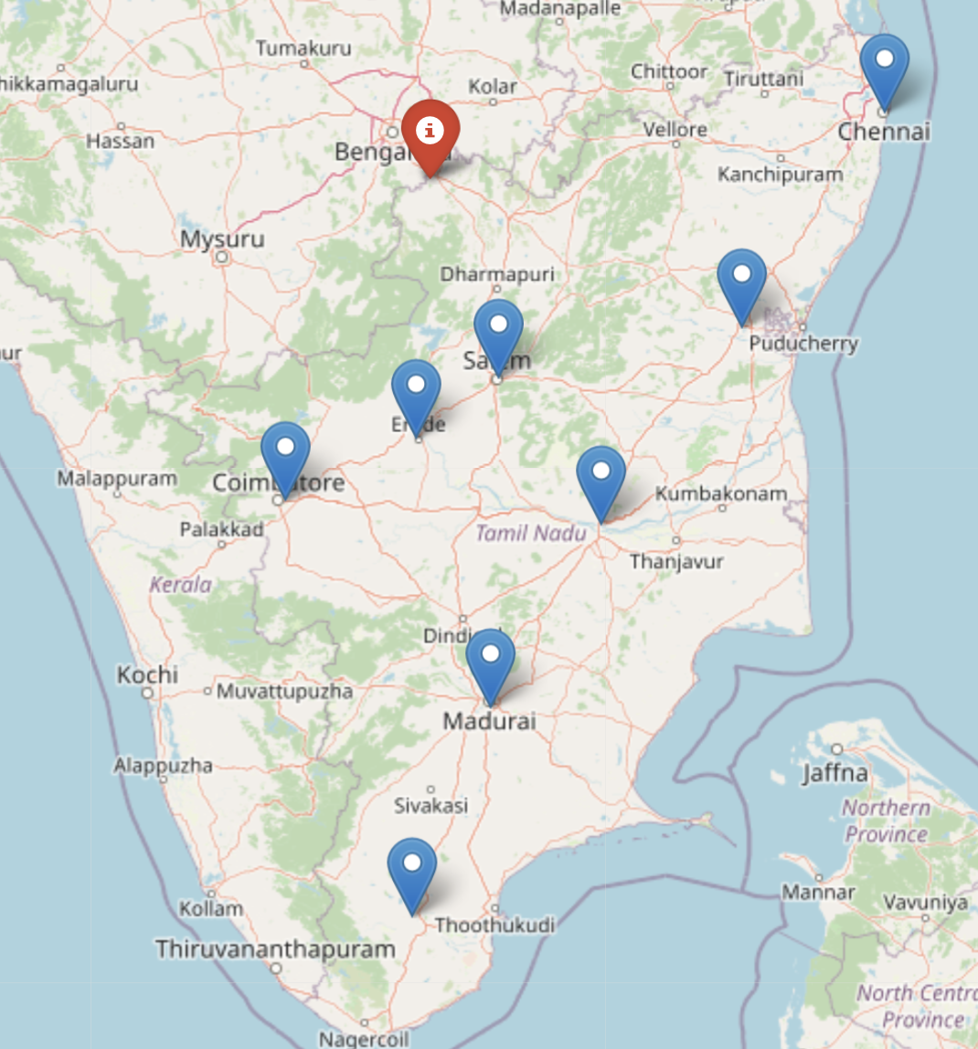
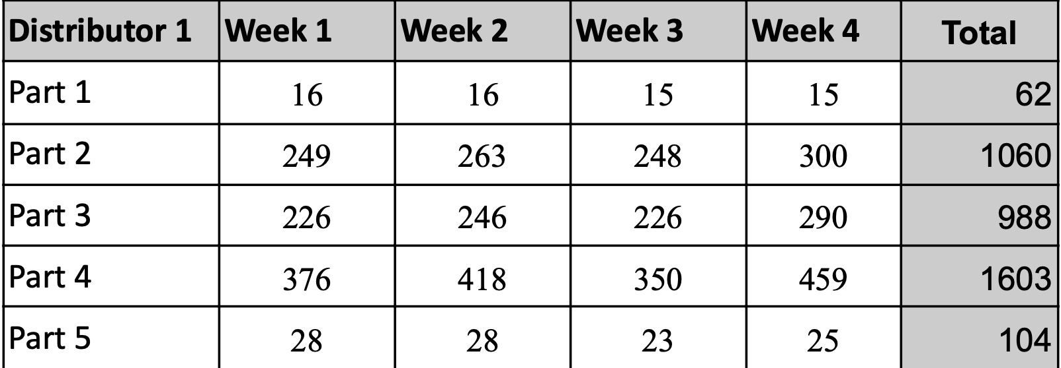
Data
Chennai
Considering 1 Distribution Center the demand data for DC1 is:
Hosur
Salem
Villupuram
Erode
Coimbatore
Trichy
Madurai
Table 1
Tirunelveli

Slide 6
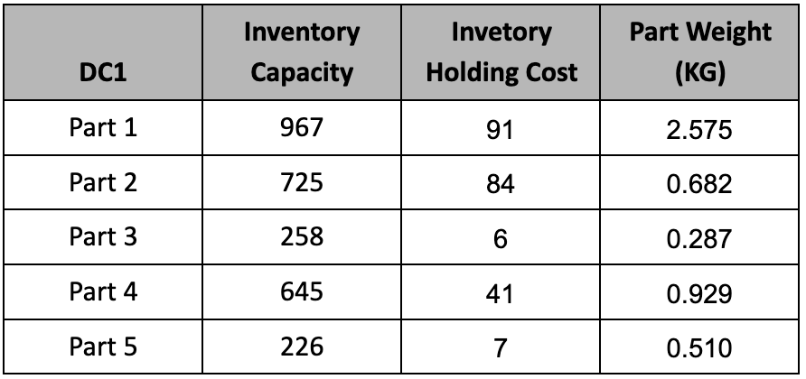
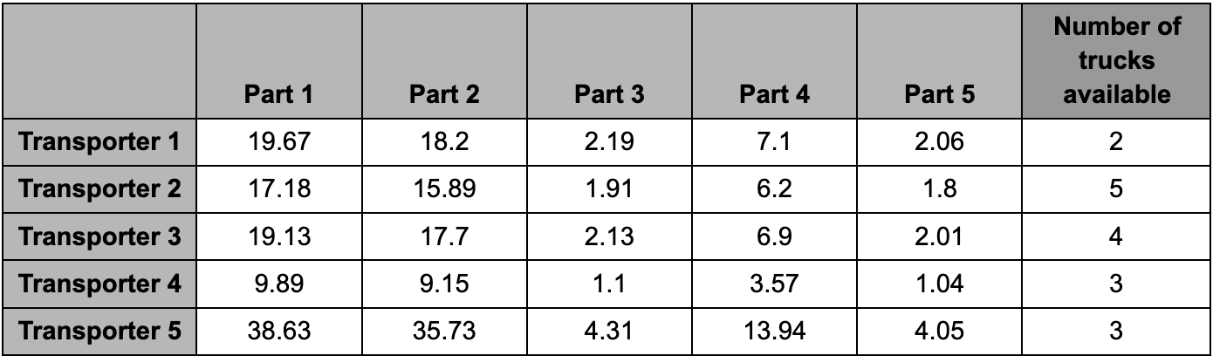
Inventory holding capacity and cost for Distributor center 1 during all time periods in table 2
Transportation charges and Number of trucks available for service based on destination to distributor center 1 in table 3
Table 2
Table 3

Slide 7
Methodology
Observation
Understanding the current model, its objectives, and its relevance to recent industrial practices and trends is essential
Observations
Preliminary data collection
Gathering preliminary data is crucial. This data will be used for calculations and fed into the model.
Data
collection
Distance matrix procurement
Google API used, for distance matrix must be collected to accurately calculate transportation distances between various locations.
Distance matrix
OR Model development
Capturing the objectives and converting operational conditions into constraints effectively.
OR Model
Testing
Testing
Full-scale implementation
Conclusion and future scope
NO.1 Presentation

Slide 8
Objective function, Decision variable and Constraints
- Decision variables (with notations)
prod_plant(‘plant’, p,w) - Production quantity of part p at the plant during the week w
transport_vars(i,p,t,w) - Quantity delivered from plant to Distribution center i, part p, transportation company t, during week
inventory_dist2(‘plant’,p,w)- Inventory levels of products needed to be maintained at the plant of part p during week w
inventory_dist1(i,p,w)- Inventory levels of part p that is needed to be
maintained at the distribution center i during week w

Slide 9
Objective function:
Minimize prob = transport_vars * cost_price + inventory_dist *inventory_holding_cost1 +inventory_dist2 * inventory_holding_cost +prod_plant * prod_price
Constraints:
Transportation: transport_vars * weight_per_unit <= transport_capacity * truck_capacity
Production: transport_vars <= production_capacity
Production Matching: transport_vars = prod_plant
Inventory Capacity:inventory_dist <= inventory_capacity
inventory_dist >= inventory_min
Demand: transport_vars >= demand
Inventory: For w=0, inventory_dist = initial_inventory,
Otherwise, inventory_dist = inventory_dist - demand + transport_vars
inventory_dist >= 0

Slide 10


Formulation:
Objective Function and Constraints are devised to yield an effective model for supply
chain management decision-making, ensuring practical and optimal outcomes.
Implementation in Solver:
Using Python with the library PuLP (Python Linear Programming)
Code Link: https://colab.research.google.com/drive/1co62krxi8y-kQ1N_ypeREdQ89JzoLCO2?usp=sharing

Slide 11
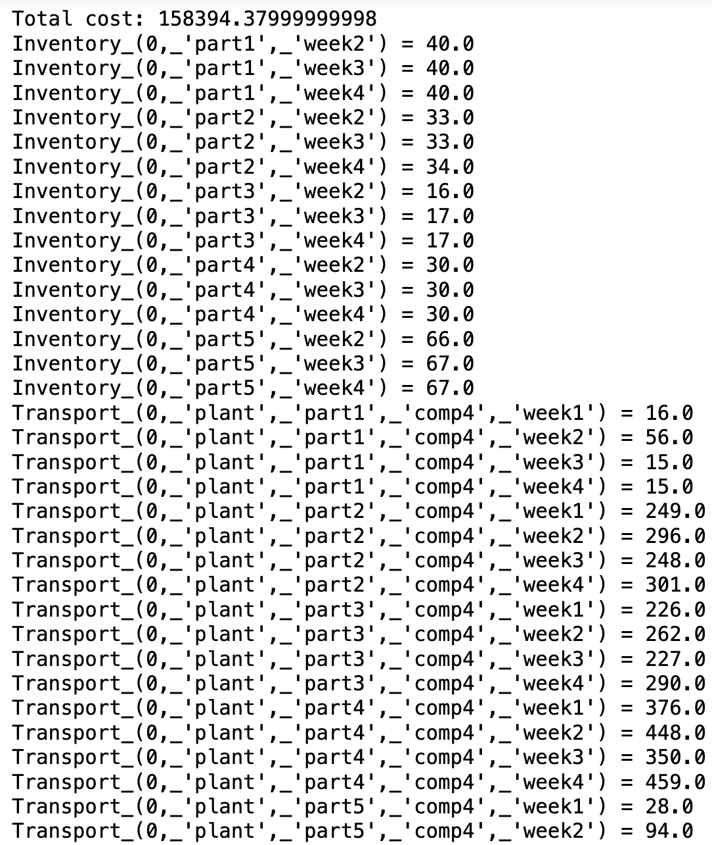

Result
Total cost after optimization is Rs. 1,58,394.38
The output from the solver is in figure 1
It indicates Inventory stored in Distribution Center 1
for part 1 in week 2 is 40
The quantity of part 2 to transported from plant to
distribution center 1 by transporter company 4 in week 1 is 249
Figure 1

Slide 12
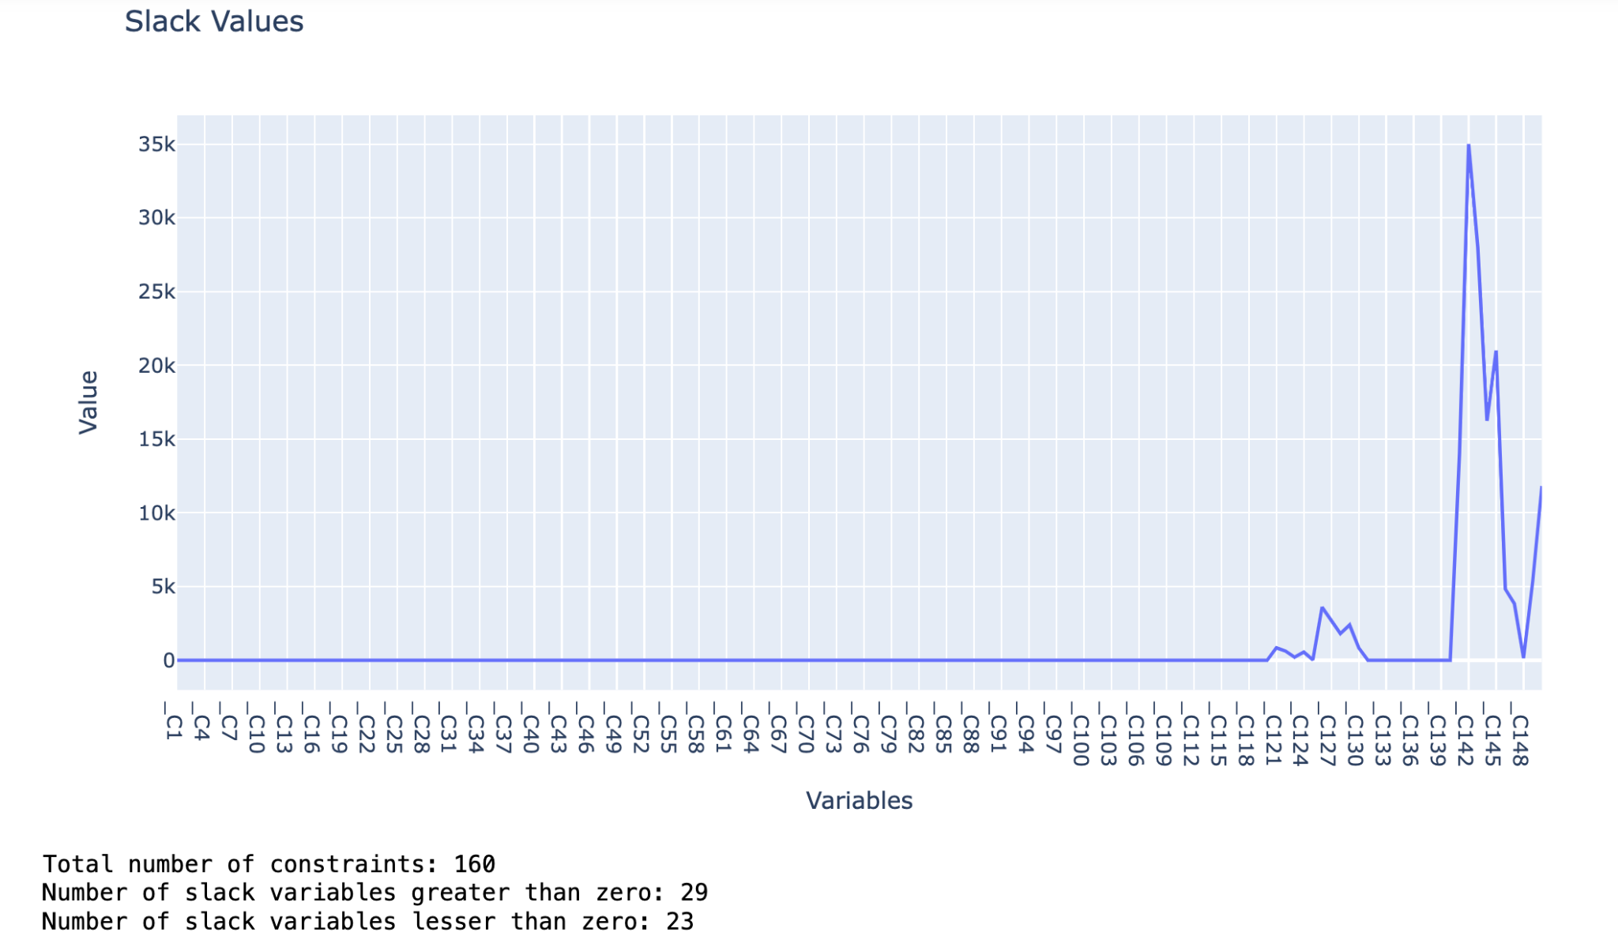
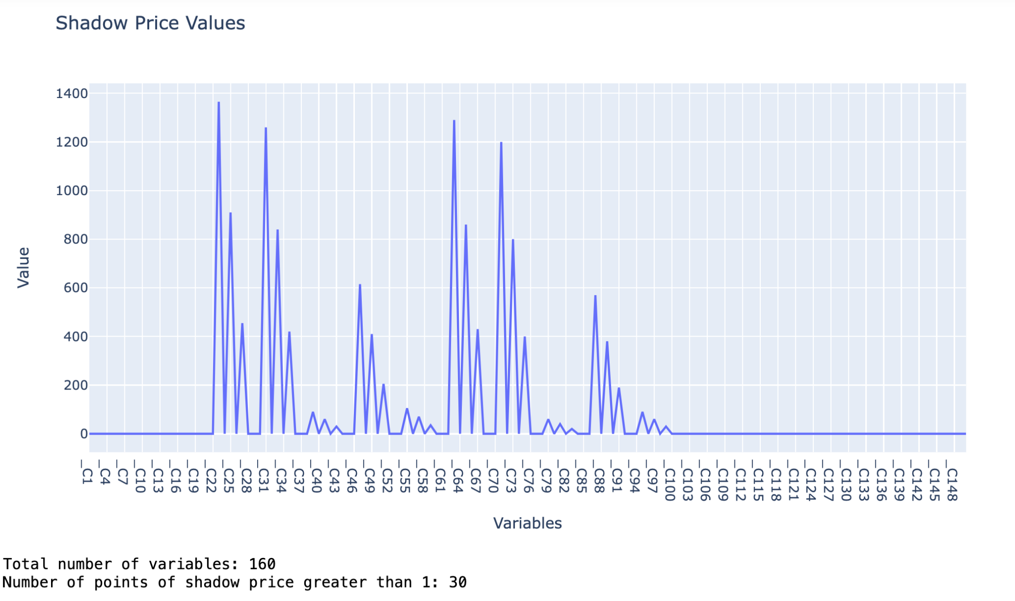
Sensitivity Analysis
160 constraints only 62 constraints are slack variables exhibited non zero values
Shadow Price is how much the objective function value would change for each unit in the right-hand side of a constraint

Slide 13
Capacitated Vehicle Routing
Total weight of the parts transported to DC1 is 2300 KG
Total 8 DC’s are there, Assume that same quantity is transported to the remaining 7 DC’s
Total truck capacity is 7000 KG
There are 5 transportes, transport
company 4 has minimum cost of
transportation there is 3 trucks
available with them
DEPOT

Slide 14
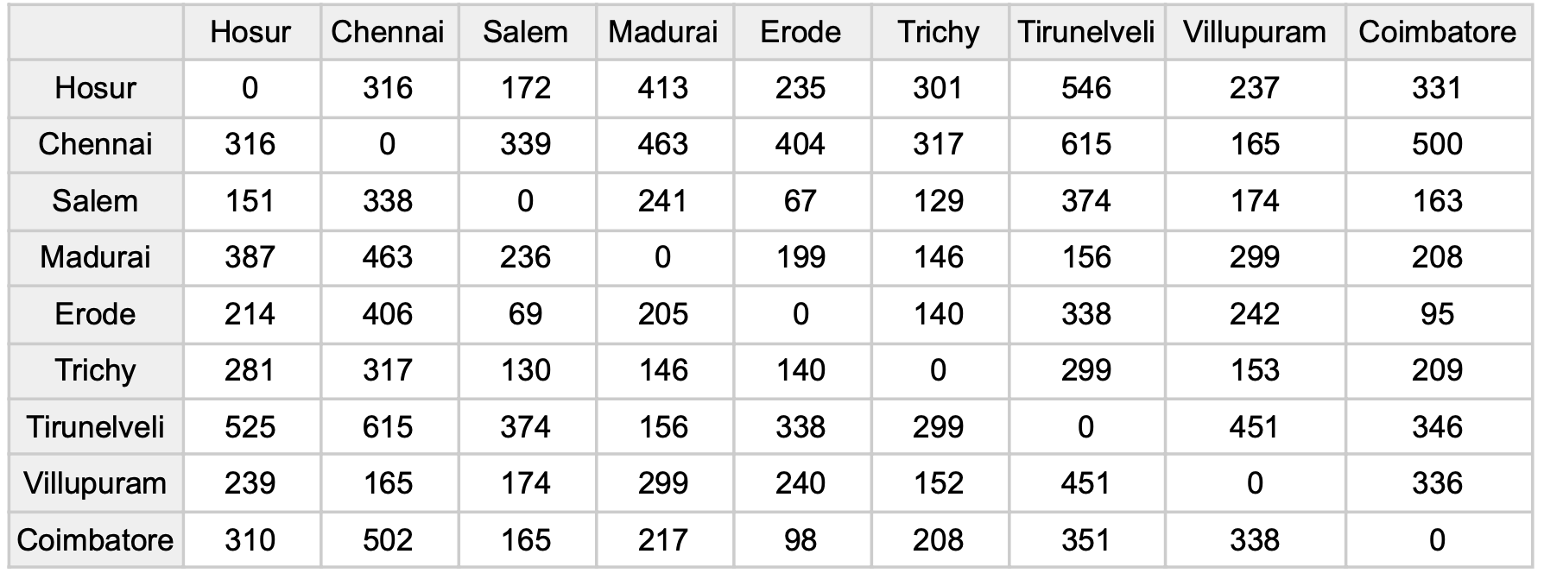
Distance Matrix Using Google Maps API

Slide 15
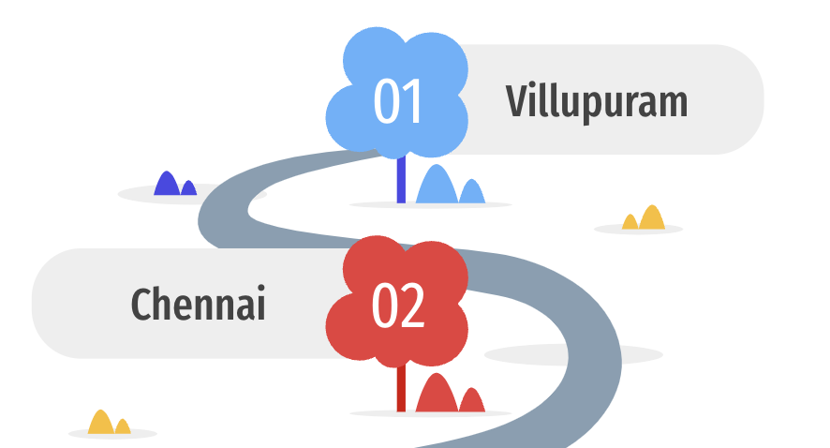
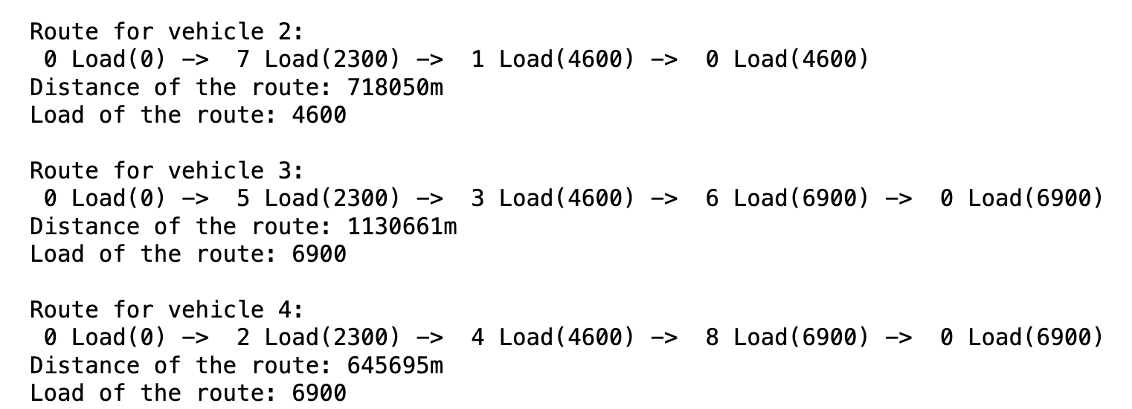
Routing
Route 1
Every Route starts and ends at the main plant Hosur
Using CVRP constraints with Google OR Tool the result of routing:
It shows the route followed by each truck 0 Load(0) -> 7 Load(2300) -> 1 Load(4600) -> 0 Load(4600)
Indicates Start from Hosur -> Villupuram -> Chennai -> Hosur

Slide 16
Due to route optimization, the total distance traveled significantly decreased from 3554.0 km to 2497.4 km, representing a reduction of 1056.6 km, or distance reduce by 29.73%
Conclusion
Route 3
Route 2
Salem
01
01
Trichy
Erode
02
Madurai
02
03
Coimbatore
03
Tirunelveli

Slide 17
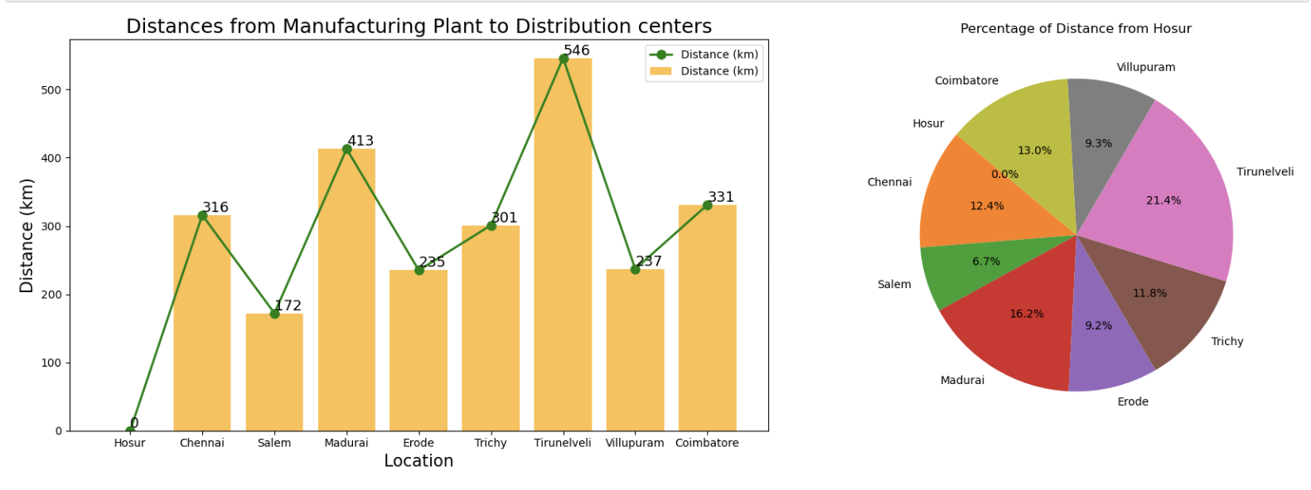
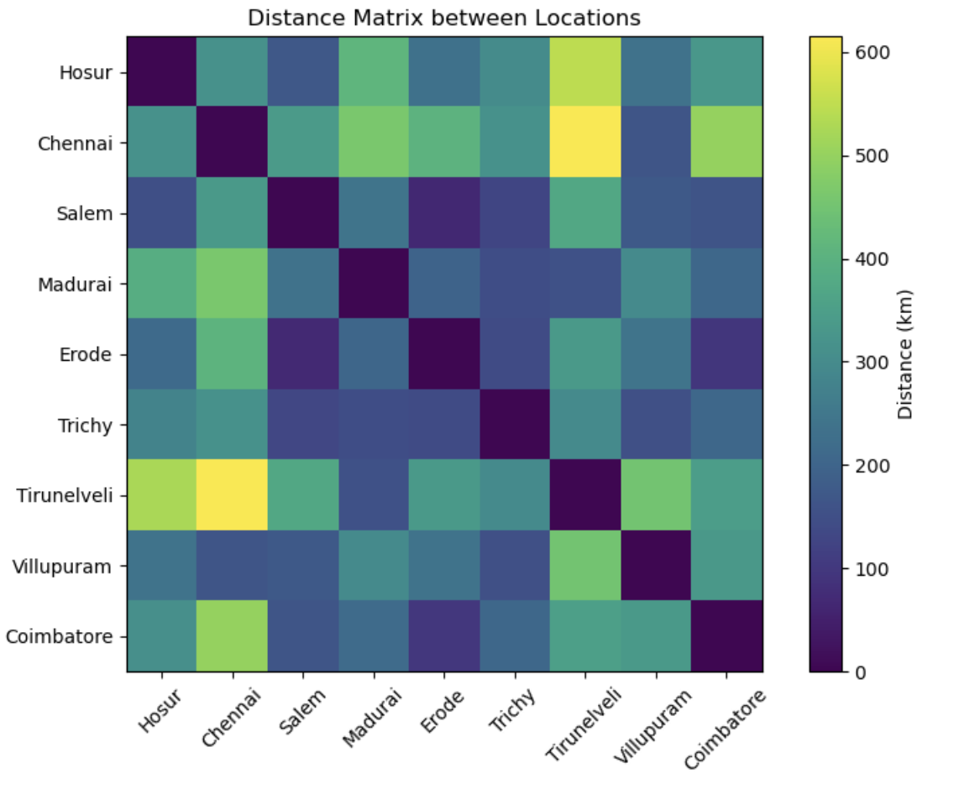
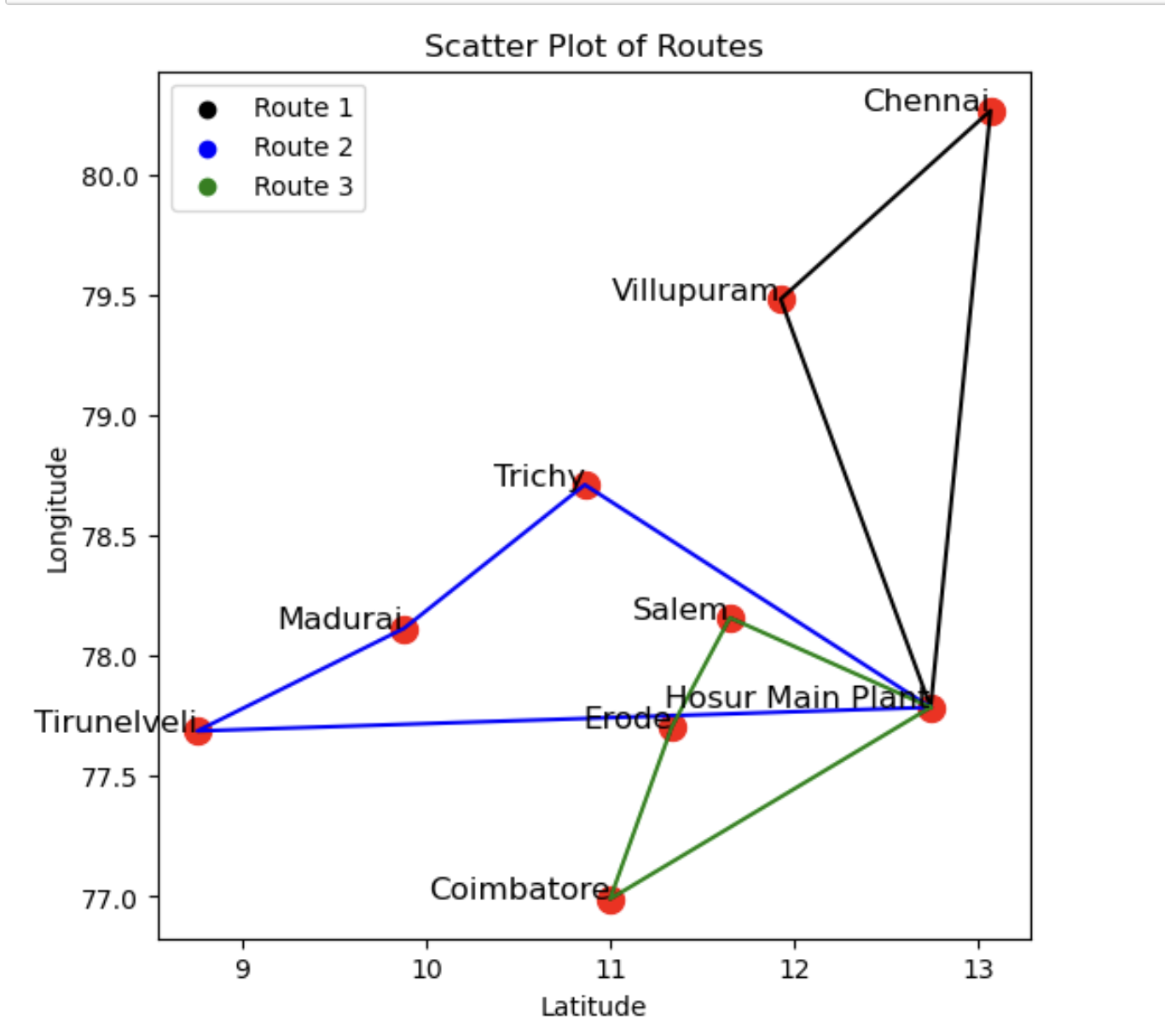
Data Visualisation
Visual Representation of distances from Hosur to the 8 distribution center
Scatter Plot of routes followed by the 3 trucks
Heat Map of Distance Matrix

Slide 18
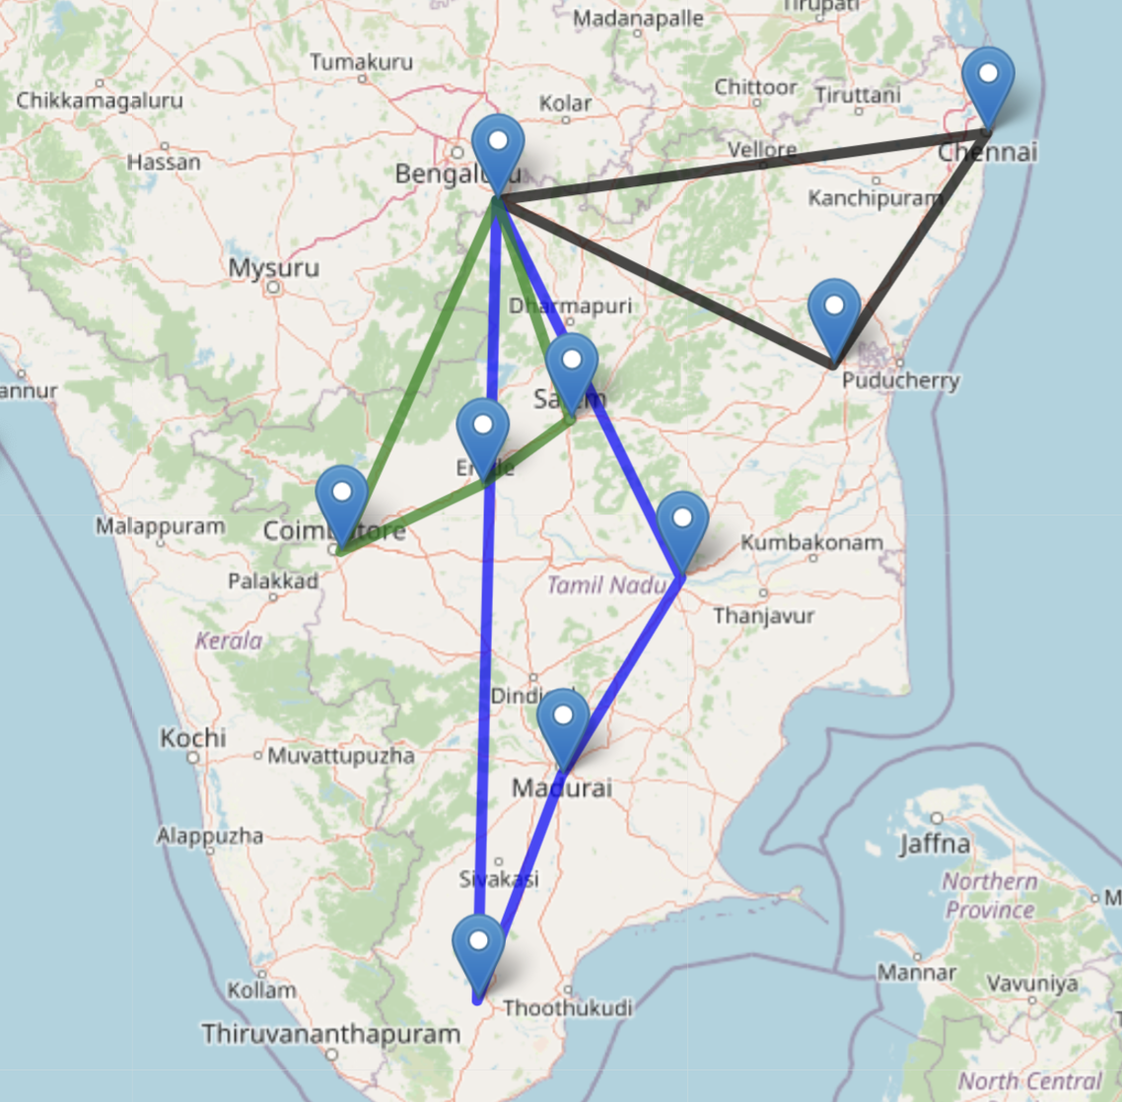
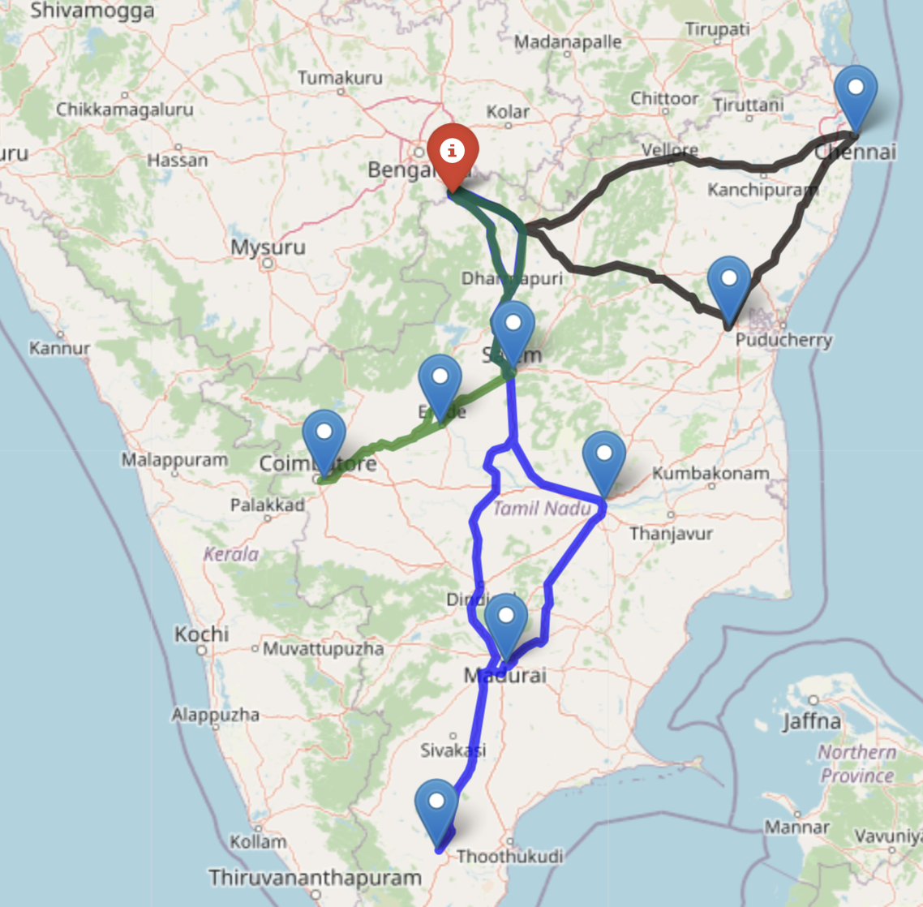
Total distance traveled was estimated through Haversine distance 2052.22 km
Actual distance travelled is 2497.408 km calculated by google maps with distance matrix
Rectified the error percentage in the distances are 17.79%
Distance calculated by Haversine distance
Route by Google Maps

Slide 19
Future Scope
If one more plant was opened in Tamil Nadu due to the high demand of products, finding the proper location by reducing transportation costs and inventory costs
Time window constraints can be added for loading and unloading for efficiently reaching the product
Identify the traffic and tame taken for the travel in the routes where truck travel using Google Maps
Different sizes of items can packed into a fixed volume of bins, in a way that minimizes the number of bins used by utilising the volume truck.

Slide 20
THANK YOU

